Slide 1
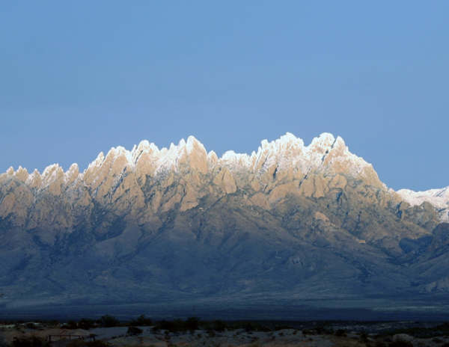


LIVESTOCK CONTROL IN THE FUTURE
-
VIRTUAL FENCING
Pembina Sheep Grazing Symposium 2014
15-16 October, 2014 Thorsby, Canada
“…natural resources and their proper use constitute the fundamental
problem which underlies almost every other problem of our national life.”
(Theodore Roosevelt December 3, 1907)
http://Jornada.nmsu.edu
JER
Notes:
Today you are going to hear about the art in using animal behavior to accomplish management goals and some of the methodologies that can be employed.

Slide 2
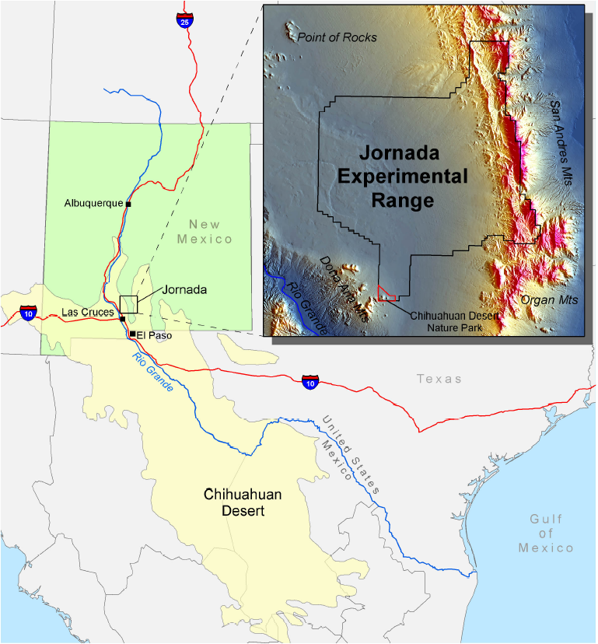
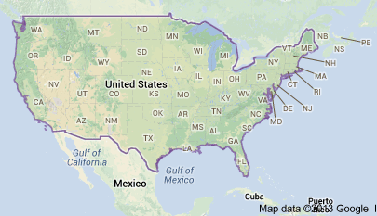
Dean M. Anderson
Research Animal Scientist
US Department of
Agriculture – Agricultural
Research Service
(USDA-ARS)
Jornada Experimental Range
(JER)
JER
Notes:
If you are like me when I go to a meeting I always want a little background on the person I am listening to in order to know if they are an expert. Now for those of you who do not know the defination of an expert, “x” in science generally stand for an unknown quantity and a “spert” is usually a drip under pressure, so this is who you have invited to speak to you and I do thank your for this opportunity. OK, now that we have broken the ice lets begin. Since 1977 I have been with the US Department of Agriculture –Agricultural Research Service as a Research Animal Scientist on the 193,000 acre Jornada Experimental Range located outside Las Cruces, New Mexico about an hours drive north of El Paso, Texas. This research location is located in the largest desert in North America, the Chihuahuan Desert. Our annual precipitation is about 9” with the 52% that falls between July August and September coming from intense, convective thunderstorms that are highly localized and of short duration. The JER represents about 40% of ARS’s land holdings in the United States. The history of the JER dates to the early 1900’s. Up until 1983 the main research thrust of the JER focused brush management and grazing use of this this semidesert grassland with cattle, then in 1983 sheep were introduced into the research program. For a complete picture of the history of the JER I would encourage you to go to usda-ars.nmsu.edu on the web and browse through the past, present and future research directions. Before moving on to the talk even though the JER research is actively involved in free-ranging animal ecology research we do not have any small ruminants on the facility at the present time.

Slide 3

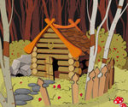
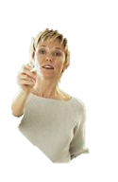
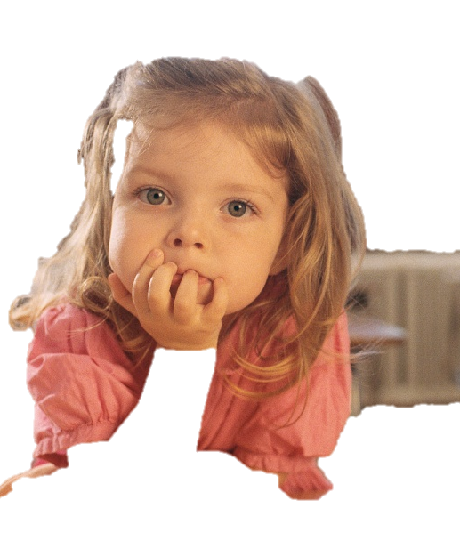
http://www.canstockphoto.com/illustration/forest.html#types:[2,4];start:375;term:forest with home
http://office.microsoft.com/en-us/images/results.aspx?qu=Academic#pg:4|
“...AND THEY CAME TO A BEAUTIFUL HOUSE IN THE WOODS.”
http://office.microsoft.com/en-us/images/results.aspx?qu=Academic&AxInstalled=copy&Download=MP900439320&ext=JPG&c=0#ai:MP900399955
JER

Slide 4


VIRTUAL FENCING CAN SUCCESSFULLY CONTROL OR MOVE FREE-RANGING CATTLE.
GPS WILL BE AN ESSENTIAL PART OF MOST FUTURE VIRTUAL FENCING SYSTEMS.
MELDING ANIMAL BEHAVIOR AND ELECTRONICS TO ACCOMPLISH MANAGEMENT GOALS REQUIRE MULTIDISCIPLINARY TEAMS.
SUPPLYING CONSISTENT POWER TO ELECTRONICS REMAINS A MAJOR CHALLENGE WHEN INSTRUMENTING FREE-RANGING ANIMALS.
SIZE OF VIRTUAL FENCING DEVICES, THEIR PLACEMENT ON THE ANIMAL AND THEIR CUE REPERTOIRE HAVE YET TO BE OPTIMIZED.

Slide 5
VIRTUAL FENCING
Background / history
Commercialization
challenges
Tools and teams
Applications
JER

Slide 6
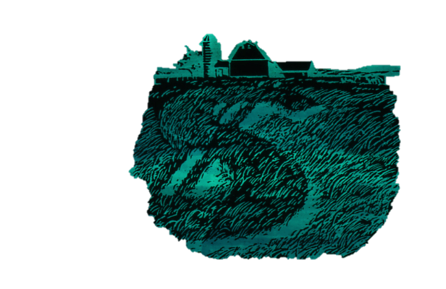
Background / history
Anderson, D. M. 2007. Virtual fencing – past, present and future. The Rangeland Journal. 29, 65-78.
Umstatter, C. 2011. The evolution of virtual fences: A review. Computers and Electronics in Agriculture. 75(1), 10-22.
JER

Slide 7
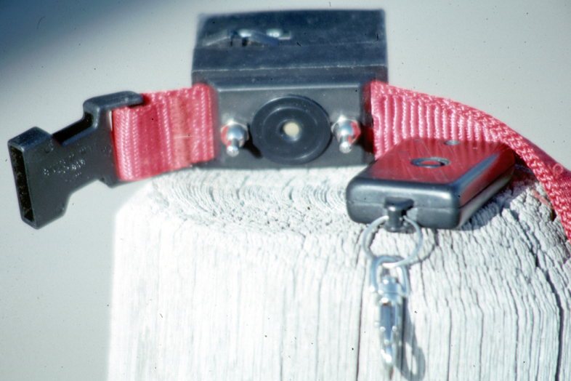
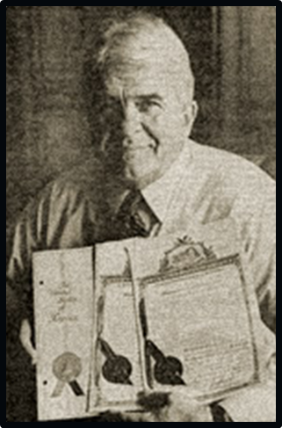
THE real FATHER of
VIRTUAL FENCING
Richard M Peck
August 1973 Patent
http://www.invisiblefence.com/our-company/company-history
JER

Slide 8
Is Conventional Fencing Adequate?
It depends
  Yes, if you can’t accept “leaky” boundaries
  No, for resource management
  Legal boundary demarcation
  ...
  Plants and animals are dynamic
  ...
JER

Slide 9
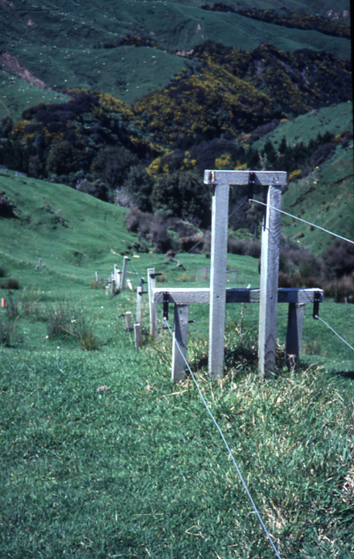
CO$T OF CONVENTIONAL WIRE FENCING, $/mile ($/kilometer)
(All in US Dollars)
JUNE 1998 DATA FROM IDAHO, MONTANA, NEW MEXICO, OREGON AND UTAH (WOVEN OR BARBED WIRE + INSTALLATION)
MEAN $4,700 ($7,562)
RANGE $1,200 TO $14,000 ($1,931 TO $22,526)
August 27, 2013 – 4 wire, steel “T” posts 20’ spacing, stays 10’ spacing
New Mexico - MATERIAL $2,647 ($4,259)
Oregon – LABOR₂₀₁₁ $3,801 ($6,116)
TOTAL $6,448 ($10,375)
2011 Globe, Arizona Materials and Labor (worst??)
$25,200 ($40,547)
JER

Slide 10
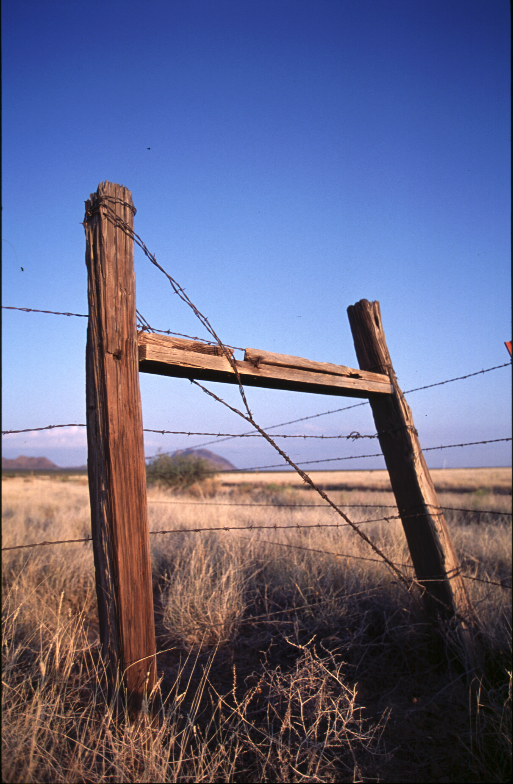
Conventional Fences Are:
IS THERE A PROBLEM WITH CONVENTIONAL FENCING?
Uneconomical to build and maintain
Undesirable aesthetically to some persons
Inflexible for managing herbivory, especially on heterogeneous landscapes
Challenging to the free movement of some wildlife
Static, yet are used to manage dynamic resources!
JER

Slide 11
After determining a proper STOCKING RATE -- THEN WHAT?
“Next to proper stocking, distribution of stock on the range is the most important feature of range management.”
1919
Jardine J. T., and Anderson, M. (1919). Range management on the National Forest. U. S. Department of Agriculture Forest Service Bulletin No. 790.
92 YEARS & COUNTING
2011
“Uneven use of rangeland by livestock continues to be a major problem . . . “
Holechek, J. L., Pieper, R. D., and Herbel, C. H. (2011). ‘Range Management: Principles and Practices.’ 6th Ed. (Pearson Education, Inc.: New Jersey.)
JER

Slide 12
An abbreviated timeline for animal control
2009 – Cattle gathered autonomously for the first time using DVF™ methodology
2004 – Began cooperation 4 May among USDA- ARS, Future Segue, MIT, RIT, Dartmouth, and CSIRO on virtual fencing research
2003 – Proof-of-concept that directional virtual fencing (DVF™) can move animals over the landscape (Anderson et al.)
2001- 2002 – Proof-of-concept that DVF™ can hold animals (Anderson et al.)
2001 – First time (April) cuing based on using global satellite navigation system (GPS)
1999 – First large scale study involving virtual fencing and cattle (Tiedemann et al.)
1989 – First report on livestock containment using virtual fencing (Fay et al.)
1974 – First commercial virtual fencing for pets (Richard Peck)
1938 – Early use of electric fencing (Bill Gallagher)
1874 – Barbed wire patented (Joseph Glidden)
JER
Notes:
Barbed wire fencing has been used to control animals since its patening 131 years ago. While electric fencing has been with us for only about 17 years look at the impact it has had on production agriculture regarding animal containment around the world. In contrast, virtual fencing has been around for over 31 years yet it was only 16 years ago that the first containment of free-ranging animals was reported using virtual fencing - Why? I believe it has to do with technology and in particular GPS.

Slide 13
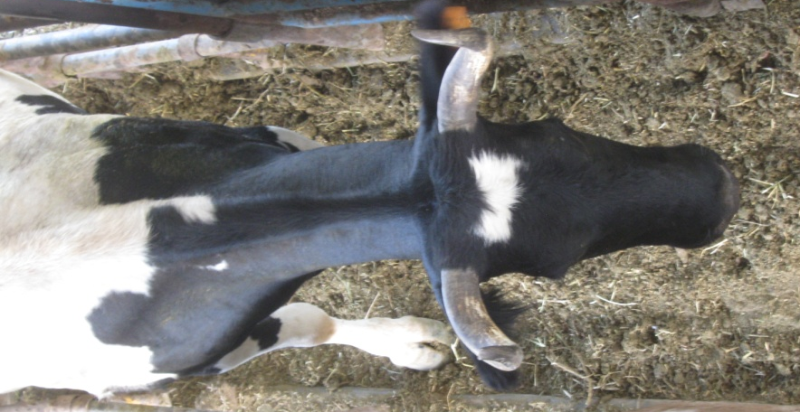
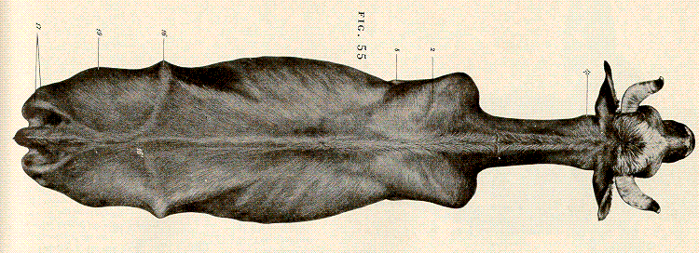
“AS THE EYES AND HEAD GO --- SO SHALL THE BODY FOLLOW “
“...TO HANDLE SEVERAL YOKES THE
DRIVER WOULD SNAP THE WHIP OFF TO ONE SIDE OF THE LEAD YOKE AND THEY WOULD VEER (SHY) TOWARD THE OPPOSITE SIDE...”
Davis, C. G. (1996). The Oskaloosa company: Last wagon train to Skinners in 1847. (Frontier Publications: Portland OR.)
Sept. 6, 2013 JER Criollo Cow
JER

Slide 14
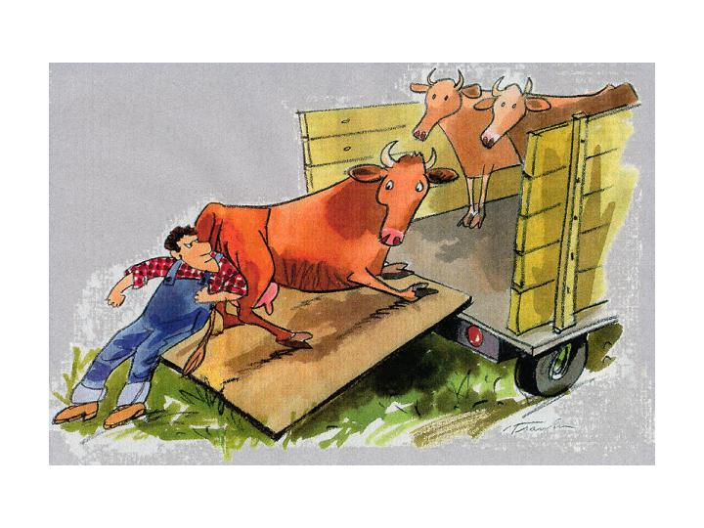
Everything we do to animals teaches them “something” – the choice is ours on what we want them to learn.
(Illustration by Don Trawin, Saturday Evening Post. (2000). 272(6), 50-51)
JER

Slide 15
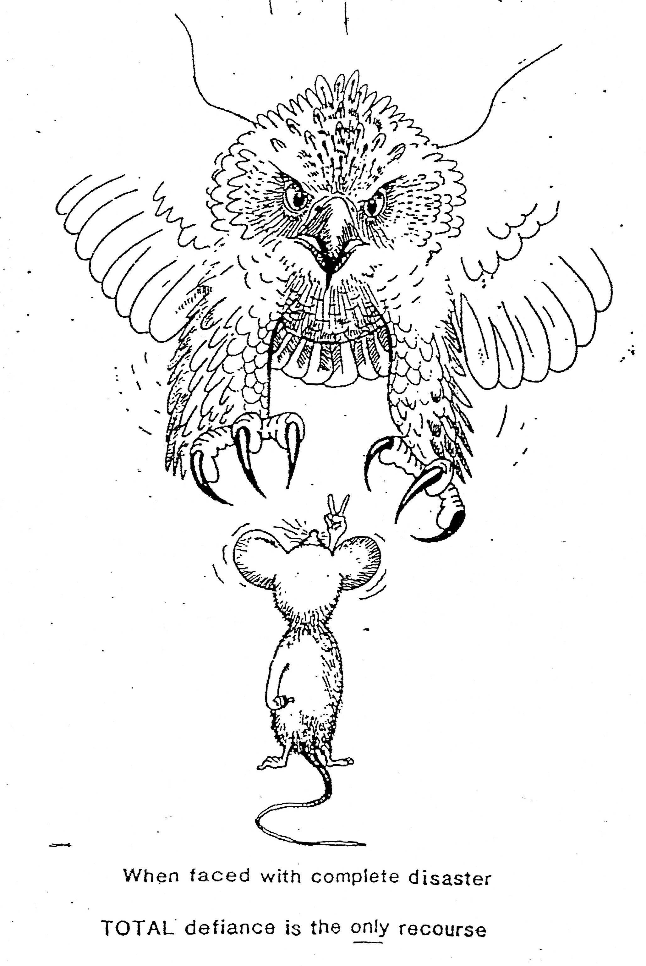
SUBTLE CUES & COMMUNICATION
“The real difficulty lies not in the tendency to interpret animal intelligence in the terms of human experience, for we have no other way; but in the faulty and imperfect analysis of human experience.” (p. 228)
Small W. S. (1901). Experimental study of the mental processes of the rat. II. American Journal of Psychology 12 (2),206-239.
JER

Slide 16
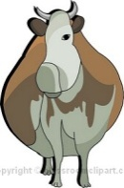
SOME BASICS ABOUT MOVEMENT
Around Every Animal Exists Three Zones
WHEN THE FLIGHT ZONE IS PENETRATED MOVEMENT OCCURS
Recognition
Flight
Fight
“A DYNAMIC FLIGHT / FIGHT INTERFACE”
For details see: Smith, B. (1998). ‘Moving ‘ em - a guide to low stress animal handling.’ (The Graziers Hui: Kamuela, HI.)
JER
J&zTi=1&sdn=webclipart&cdn=compute&tm=11&gps=325_429_1516_777&f=00&tt=14&bt=0&bts=0&zu=http%3A//classroomclipart.com/cgi-bin/kids/imageFolio.cgi%3Fdirect%3DClipart/Animals/Cow_Clipart

Slide 17
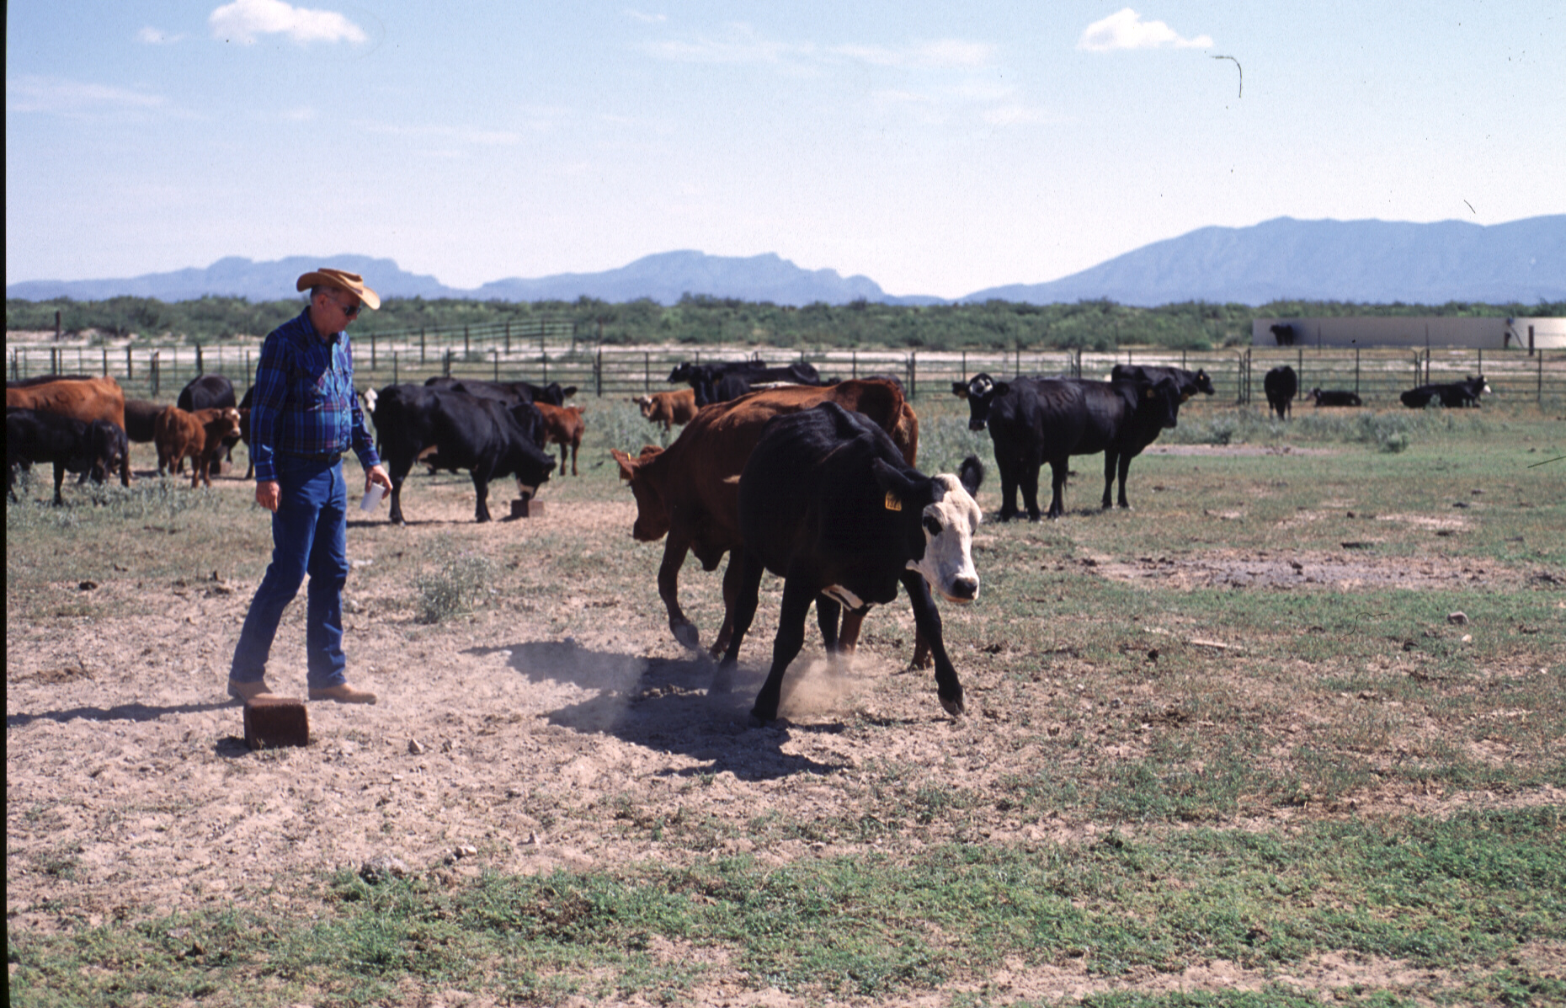
The “Correct” Response
JER

Slide 18
There Can Be Another Response
JER

Slide 19
TOOLS AND TEAMS
1. Anderson, D. M. 2010. Geospatial methods and data analysis for assessing distribution of grazing livestock. In: ‘Proceedings 4th Grazing Livestock Nutrition Conference’. (Eds. B. W. Hess, T. DelCurto, J. G. P. Bowman and R. C. Waterman.) pp. 57-91. (Western Section American Society Animal Science: Champaign, IL.)
2. Anderson, D. M. 2011. Tools to study and manage grazing behavior at multiple scales to enhance the sustainability of livestock production systems. In: ‘Proceedings IX International Rangeland Congress’. (Eds S. R. Feldman, G. E. Oliva, and M. B. Sacido.) pp. 559-564. (IX IRC 201: Rosario, Argentina.)
3. Anderson, D. M., Estell, R. E., and Cibils, A. F. 2013. Spatiotemporal cattle data – a plea for protocol standardization. Positioning. 4, 115-136.
JER

Slide 20

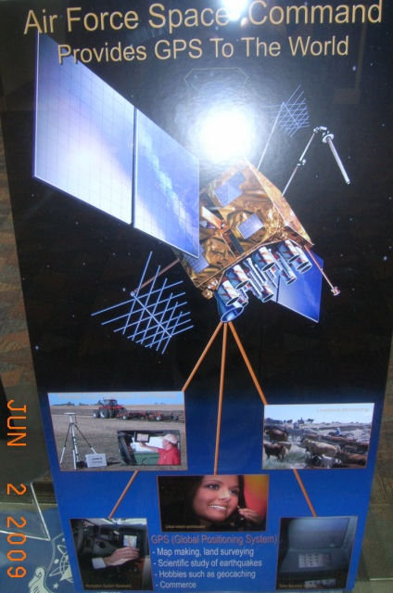
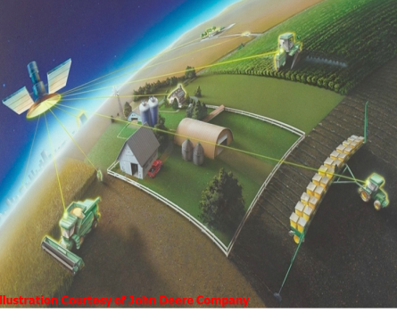
GLOBAL NAVIGATION SATELLITE SYSTEM (GNSS) - APPLICATIONS
Since the 1990’s
Source: https://spiral.imperial.ac.uk/bitstream/10044/1/11163/2/WSchuster_GNSS-Conference_Baska2013_keynote_130419.pdf
JER

Slide 21
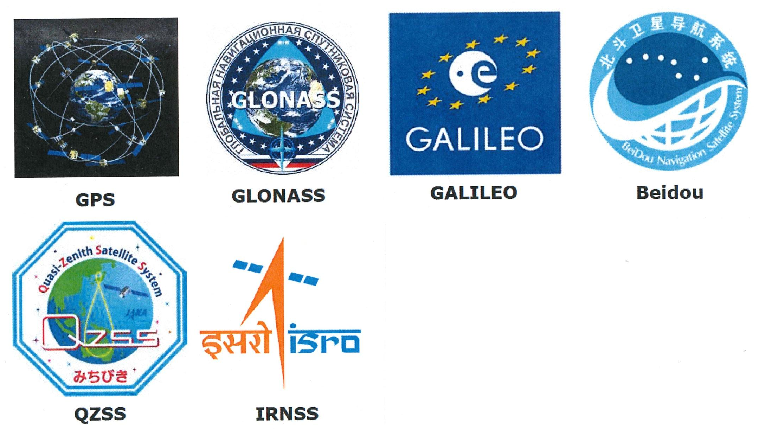
MULTIPLE SYSTEMS AND SIGNALS
You can’t manage that which you can not measure
Source:
https://spiral.imperial.ac.uk/bitstream/10044/1/11163/2/WSchuster_GNSS-Conference_Baska2013_keynote_130419.pdf
JER

Slide 22
SATELLITE IMAGE RESOLUTION
JER

Slide 23
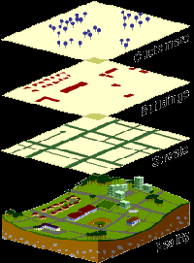
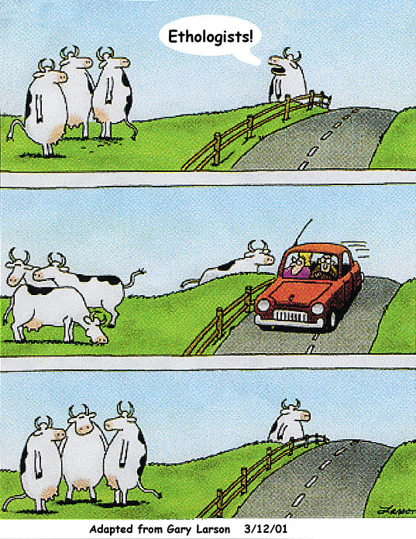
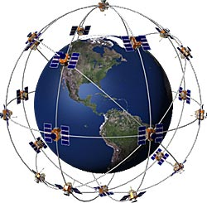
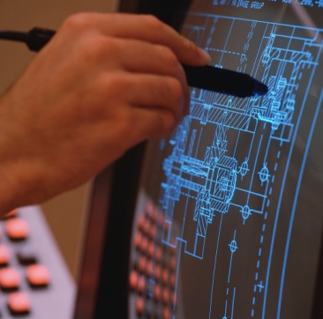
MELDING OF DISCIPLINES
(TEAMS)
http://www.garmin.com/aboutGPS/
http://www.gis.com/whatisgis/
Global Navigation Satellite System (GNSS)
Geographic Information System (GIS) Technology
/
Biology
Especially Animal Behavior (Ethology)
Wireless Communication
Engineering
JER

Slide 24
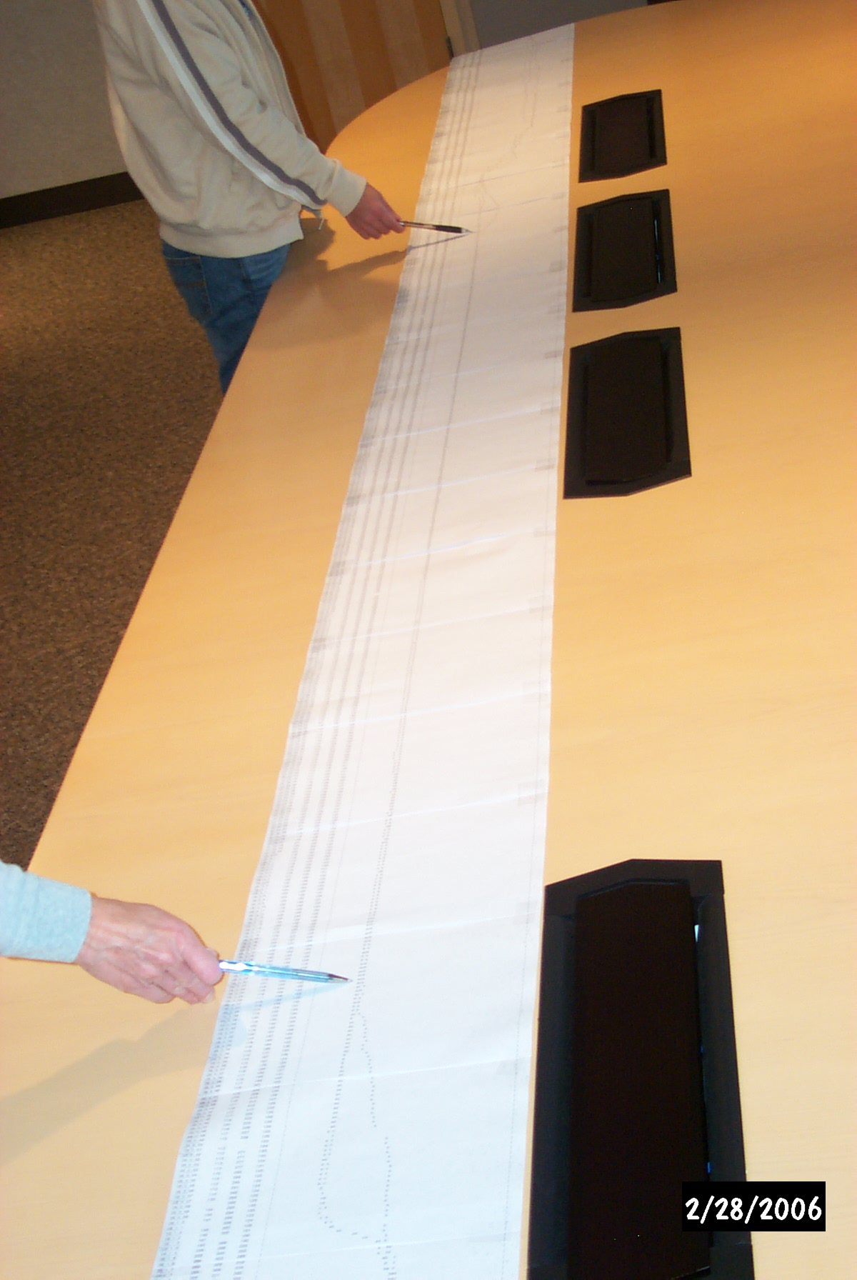
“Frequently a picture is worth a 1000 words”
JER

Slide 25
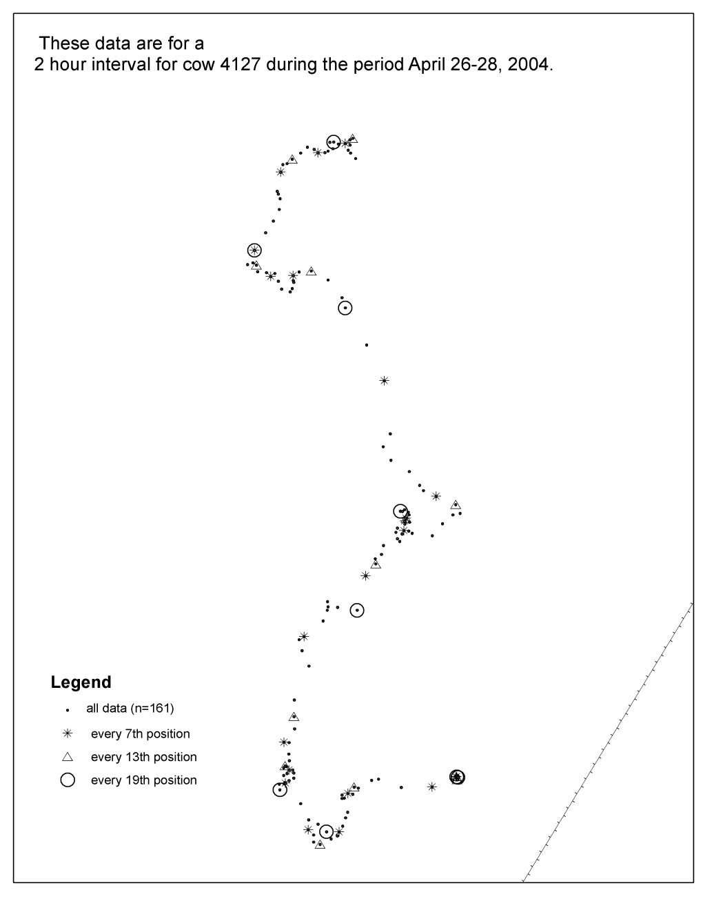
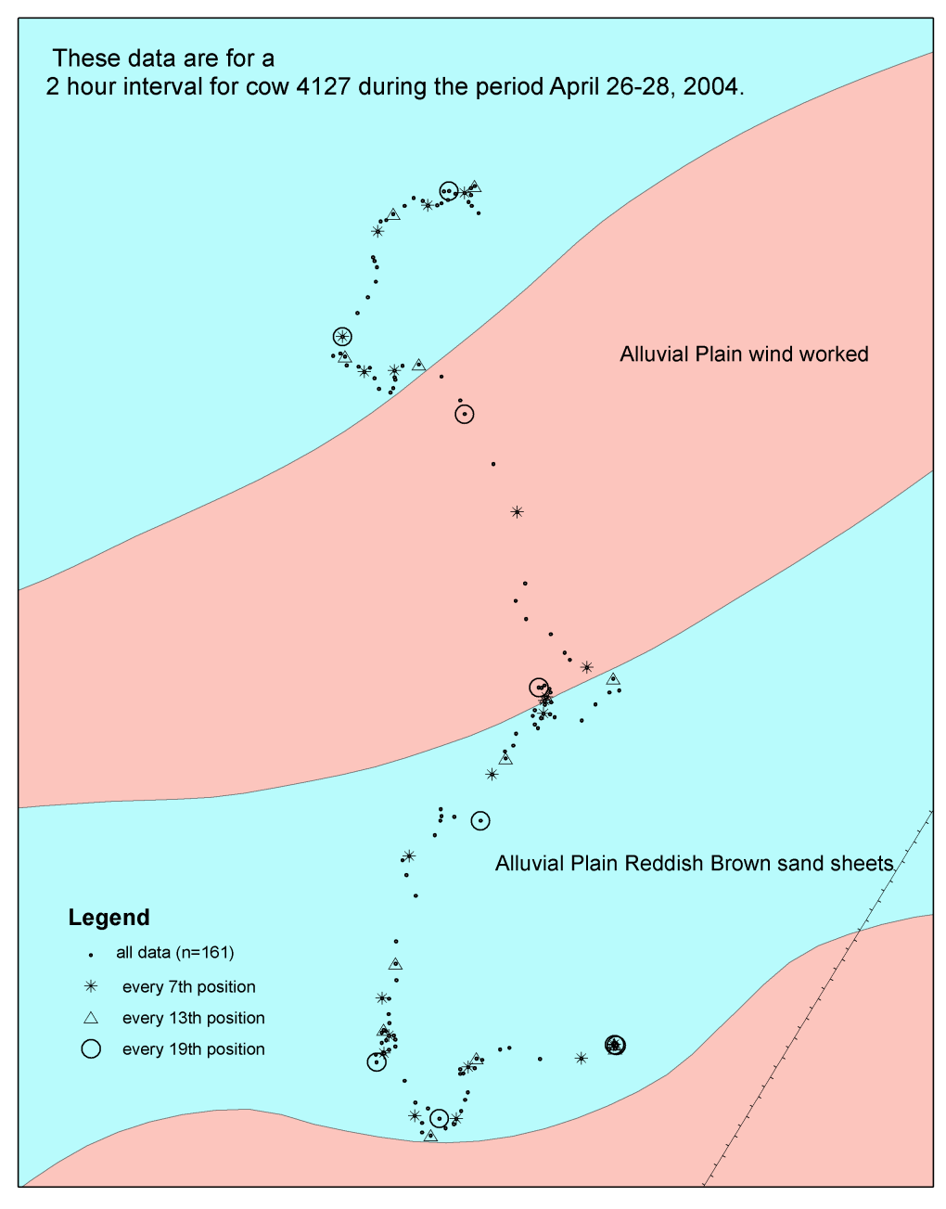
HOW FREQUENTLY DO WE NEED TO RECORD DATA?
JER

Slide 26
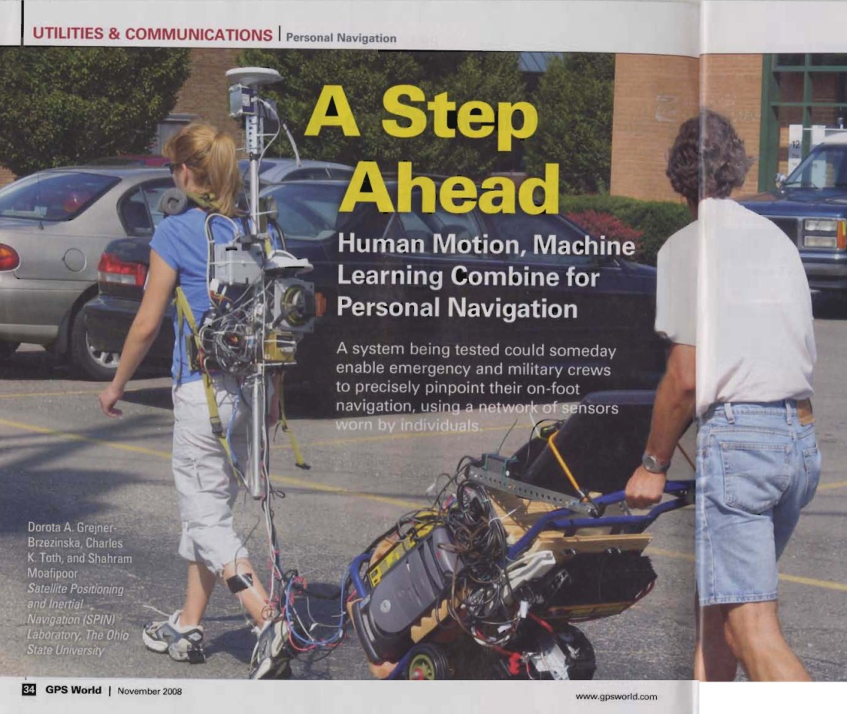
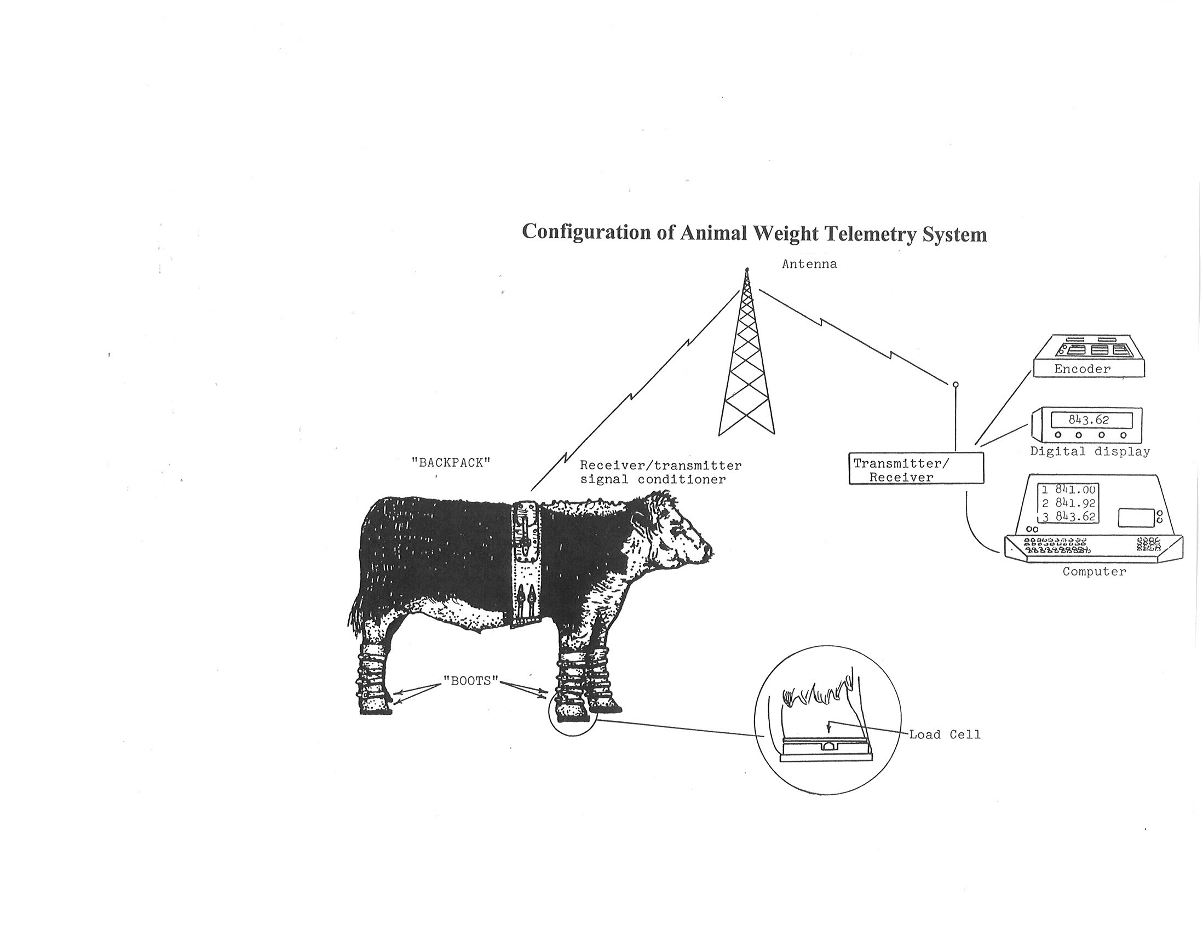
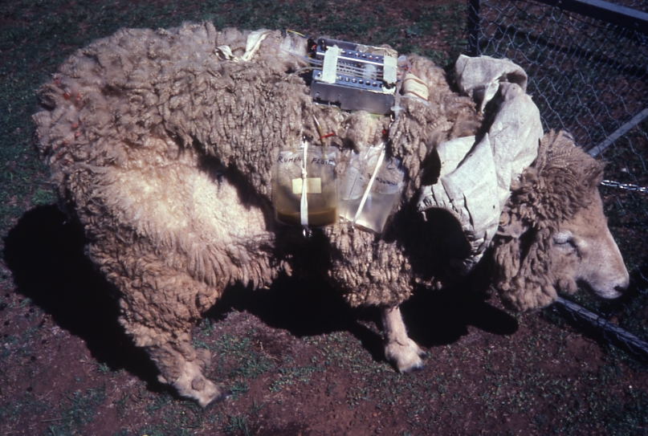
How is the observer
influencing the observation
?
Adapted from: Horn, F. P. (1981). Direct measurement of voluntary intake of grazing livestock by telemetry. In: “Forage evaluation and utilization – an appraisal of concepts and techniques’. Armidale, NSW 27-31 October, 1980. (Eds. J. L. Wheeler and R. D. Mochrie .) pp. 367-372. (Netley, South Australia.)
JER

Slide 27
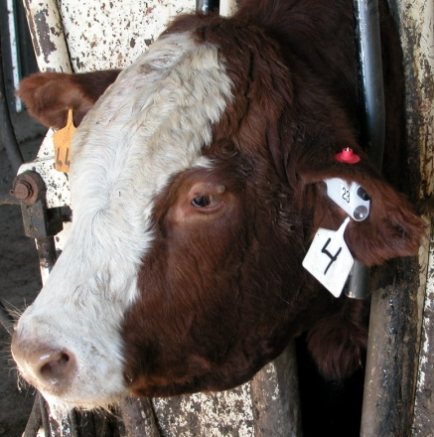
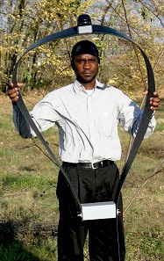
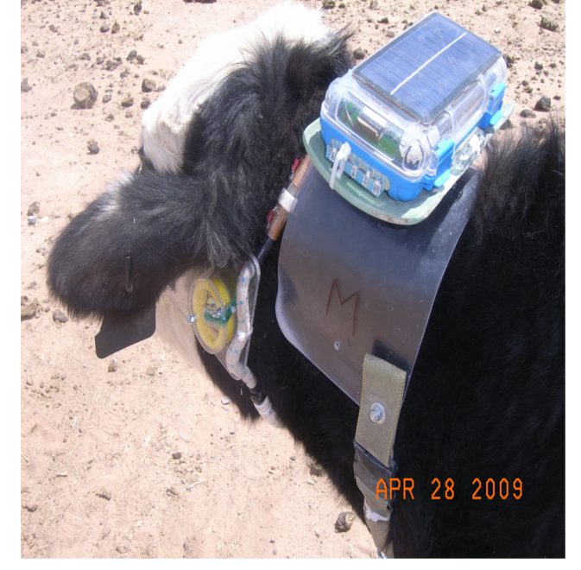
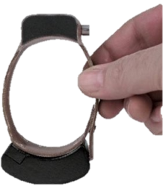
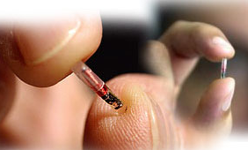
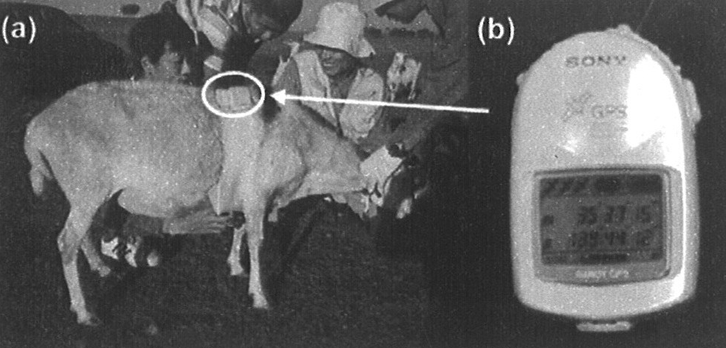
ElectronicS Platforms
A 227 g Ear Tag
Schleppe, J. B. et al. (2010). Challenges in the
design of a GNSS ear tag for feedlot cattle.
Computers and Electronics in Agriculture
70(1), 84-95.
GPS GSM Plus 5 collar for elephants
http://www.environmental-studies.de/products/01/gps-collar.html
A mature cow can carry a 3.2 kg (7.1 lb.) neck saddle for extended periods w/o stress – rule of thumb equipment should not exceed 3% of animal’s mass
80 g GPS collar for smaller species that are not easily re-trapped
http://www.biotrack.co.uk/gps.php
Kawamura, K. et al. (2005). Quantifying grazing intensities using geographic information systems and satellite remote sensing in the Xilingol steppe region, Inner Mongolia, China. Agriculture, Ecosystems and Environment 107, 83-93.
Implantable GPS ?
http://www.gpsmagazine.com/2008/08/implantable_gps_tracking_arriv.php
JER

Slide 28
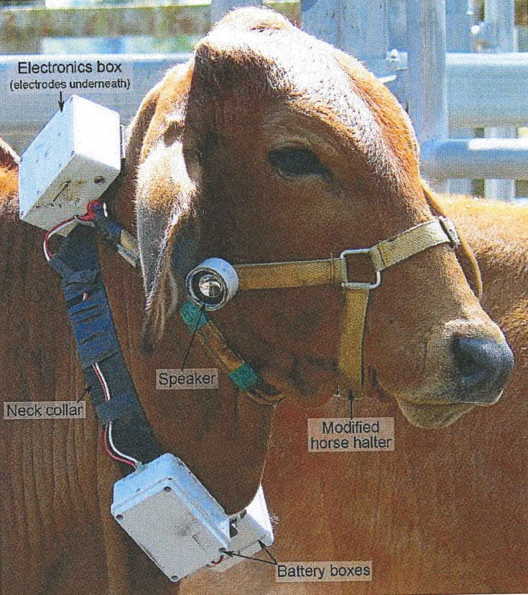
HOW TIGHT SHOULD COLARS BE?
Source: Ruiz-Mirazo, J., Bishop-Hurley, G. J., and Swain, D. L. (2011). Automated animal control: Can discontinuous monitoring and aversive stimulation modify cattle grazing behavior? Rangeland Ecology and Management 64, 240-248.
JER

Slide 29
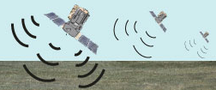
COLLAR ROTATION – how important is “a”?
GNSS LOCATION
b
c
a
SOIL SURFACE
Collars : http://www.une.edu.au/parg/documents/parg-tracking
JER

Slide 30
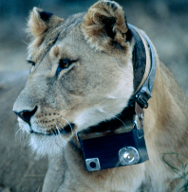
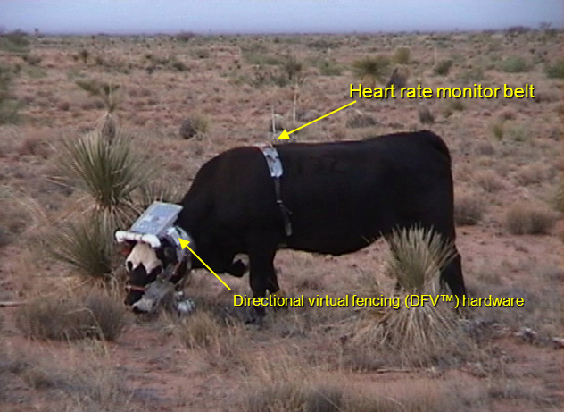
OTHER ELECTRONICS
http://searesearch.org/animals-and-exhibits/exhibits/716-crittercam
Anderson, D. M., Remenyi, N., and Murray, L. W. (2011). Using time-series intervention analysis to model cow heart rate affected by programmed audio and environmental/ physiological cues. In: ‘Proceedings of the 22nd Annual Kansas State University Conference on applied statistics in Agriculture.’ (Ed W. Song.) pp. 107-136. (Kansas State Department of Statistics: Manhattan.) Accessed June 4, 2013 at: http://jornada.nmsu.edu/bibliography/10-045.pdf
Origin of Crittercam
Crittercam was conceived in 1986 by marine biologist and filmmaker Greg Marshall.
JER

Slide 31
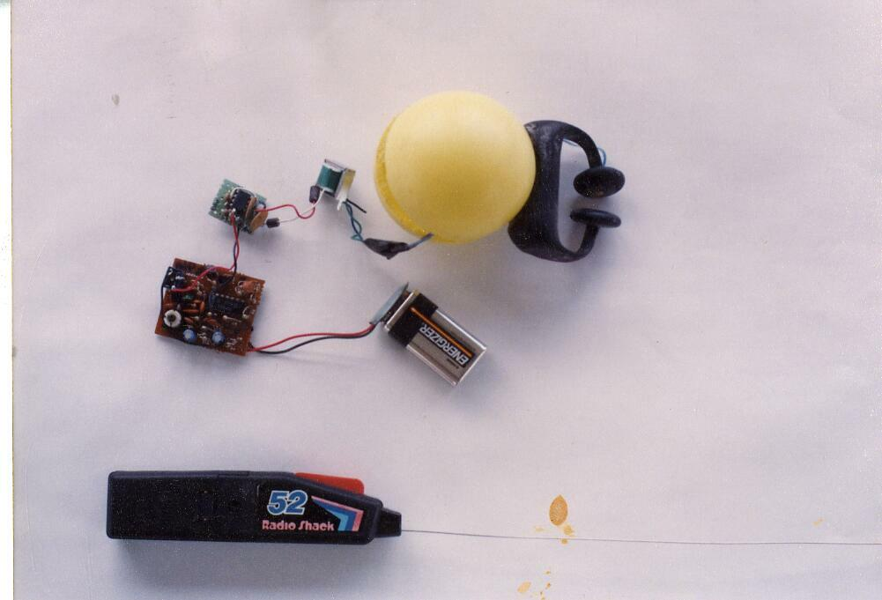
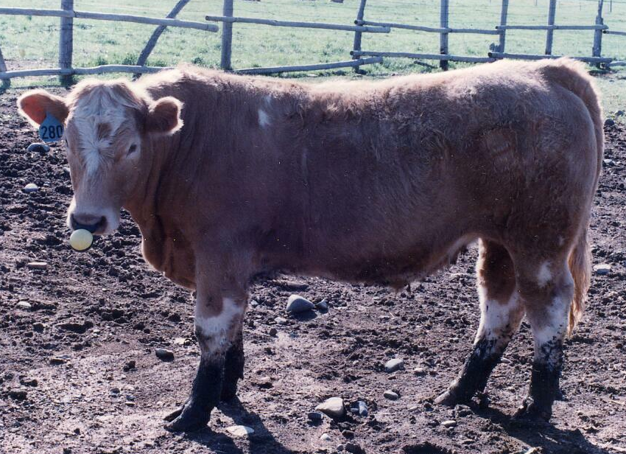
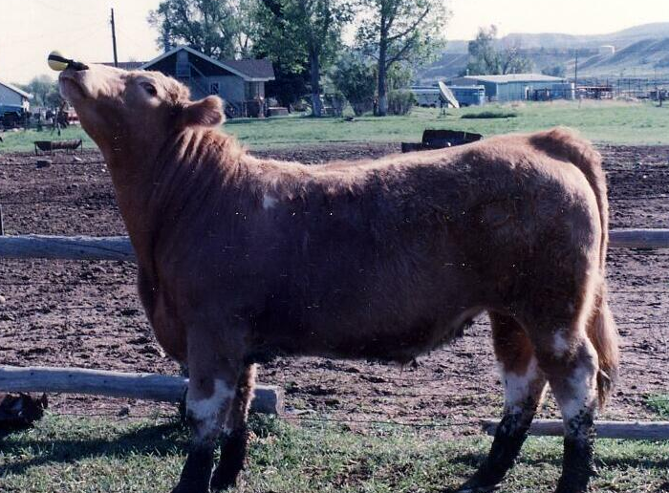
PROPOSED - BUT
Before stimulation >
< “Control level”
stimulation
From Andrew F. Rose; Gould Ranch Meeteetse, Wyoming 10-29-93
JER

Slide 32
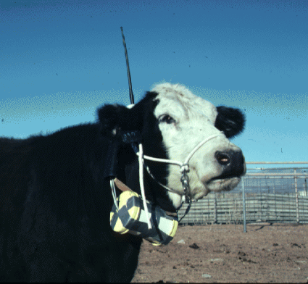
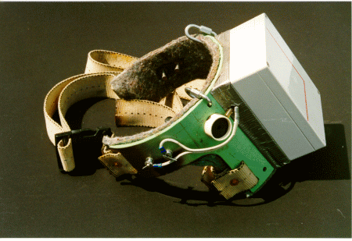
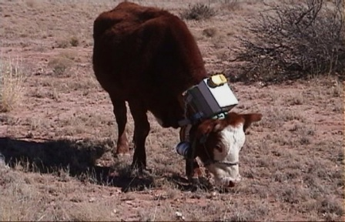
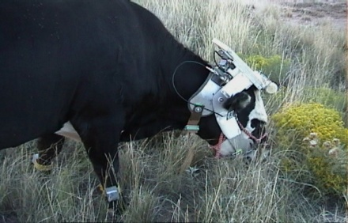
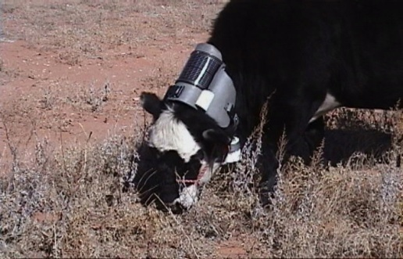
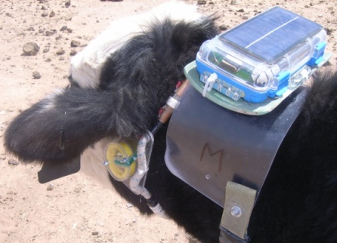
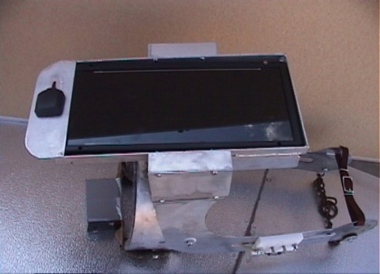




Directional Virtual Fencing (DVF™)
Hand held
activator
Electronics compartment
Two
electrodes
Speaker
Piezo
Hand held
activator
Two electrodes
Prototype I
1997
Neck Saddle Prototype II
1998
Version 1 with GPS
Version 2 GPS + solar
Neck Belt Prototype IV 2004
Stretch halter – neck saddle 2008-11
GPS Antenna
Rigid
solar panel
Right
Piezo
Two electrodes
Battery
Neck Saddle, Jaw bone design, Prototype III
1999 - 2003
Ear-A-Round (EAR™) 2005
JER

Slide 33




Instrumenting & De-instrumenting animals
Installing a GPS collar using restraint
Smith, B. (1998). ‘Moving ‘ em - a guide to low stress animal handling.’ (The Graziers Hui: Kamuela, HI.)
Low stress animal handling
is THE KEY
http://repository.tamu.edu/bitstream/handle/1969.1/86125/TR334%20Environmental%20Managment%20of%20Grazing%20Lands%2010-08..pdf?sequence=1
Installing a GPS neck-saddle using
patience & “cow time”
JER
http://www.azgfd.gov/w_c/Marked_Animals.shtml

Slide 34



The “Dust Factor”
(Low Stress Animal Handling)
Smith, B. (1998). ‘Moving ‘ em - a guide to low stress animal handling.’ (The Graziers Hui: Kamuela, HI.)

Slide 35

Commercialization challenges
(QUESTIONS YET TO BE FULLY ANSWERED)
An overview
http://www.theatlantic.com/technology/archive/2013/02/the-land-of-the-free-how-virtual-fences-will-transform-rural-america/272957/

Slide 36

You must accept “leaky” boundaries
If the health or safety of either humans or animals must not be compromised,
… Do Not Use Virtual Fencing
http://happyimages.net/tag/clip-art-key
JER

Slide 37

QUESTIONS YET TO BE ANSWERED WHEN USING
VIRTUAL FENCING
“When did you start seeing the invisible fence?”
Source: Australian Readers Digest 2006
JER

Slide 38
APPLYING SENSORY CUES
ONE RESPONSE
IF
JER

Slide 39

How Much Cue To Apply?
“Maybe that 200-volt, 50-amp training collar wasn’t such a good idea after all.
SHOCK
ONLY AS A LAST RESORT
The Varmint Hunter Magazine, January 1997, p. 112
JER

Slide 40
How Is Cuing?
STRESSFUL
JER

Slide 41

When To Apply Cues?
Only when an animal is moving
Source: Macaulay Land Use Institute 1999 Ann. Rep. p. 41. http://www.mluri.sari.ac.uk/anrep99
JER

Slide 42




power
Solar
Battery Voltage Energy
Density Pros Cons
Kinetic
3.7 V
17 Ah
http://www.iccnexergy.com/battery-chemistry-comparison-chart/
Rome, L. C., inventor. (2004). Backpack for harvesting electrical energy during walking and for minimizing shoulder strain. U.S. Patent 2004/0183306 A1.
September 23. 32 p. Int. Cl⁷. H02P 9/04. Accessed August 21, 2013 through http://pat2pdf.org/

Slide 43


Equipment
-
Must Be Robust

Slide 44




EAR TAGS – THE FAMILIAR
Electronic Identification
̴ Tag mass 20 to 22 g
Harvesting
Energy of
Motion
+
Battery
Storage
Photovoltaic
Electronics
http://www.taggle.com.au/livestock.php

Slide 45

How Much Should Electronic Ear Tags
Weigh?
http://www.rivers.gov.au/research/demoeval/virtfence.htm
JER

Slide 46
PROPOSED - THE EAR-A-ROUND
Anderson, D. M., inventor; The United States of America as represented by the Secretary of Agriculture , assignee. (2010). Ear-A-Round equipment platform for animals. US Patent 7,753,007 B1. July 13. 14p. Int. Cl. A01K15/02. Accessed September 3, 2013 through: http://www.pat2pdf.org/
JER

Slide 47

Maybe?
Xu, S., Talwar, S.K., Hawley, E.S., Li, L., and Chapin, J.K. (2004). A
multi-channel telemetry system for brain microstimulation in freely
roaming animals. Journal of Neuroscience Methods 133(1-2), 57-63.
JER

Slide 48
How many animals should you instrument?
IT DEPENDS ON…
?
$
The team
JER
Notes:
Why two individuals of the same species may be moving differently:
The two may be experiencing different environments
They may have different phenotypes
They may have different past experiences
They may have different personalities
Morales et al. 2010. Building the bridge between animal movement and population dynamics.
Philoosophical Transactions of the Royal Society B. 365: 2289-2301.

Slide 49


$
When will virtual fencing
become
a commercial reality ?
CHANGE WILL OCCUR –
WHEN THE COST OF DOING BUSINESS IN THE SAME “OLD WAY” DOES NOT MEET THE DEMANDS, GOALS AND ECONOMICS OF THE CURRENT SITUATION.
LIFE STYLE
LEGISLATION

Slide 50
THE PSYCHOLOGY THAT
WILL LEAD TO THE USE OF
VIRTUAL FENCING
“Men will make the necessary effort to improve and protect the range only
when they are absolutely guaranteed that whatever benefit may come
as the result of their efforts shall become their own gain.”
Page 28 -- E. O. Wooton 1908 The range problem in New Mexico.
New Mexico Agricultural Experiment Station, Bulletin 66, 46 pp.

Slide 51
COST
≤ $__________ PER HEAD

Slide 52

APPLICATIONS
JER

Slide 53


Directional Virtual Fencing (DVF™)
Theory of operation
Key : (+) Indicates increasing intensity
1 = Virtual Boundary (VB™), 200 m wide
2 = Virtual Paddock (VP™) with animals
3 = (+) sound only
4 = (+) sound & (+) electrical stimulation
5 = (++) sound & (++) electrical stimulation
6 = (+++) sound & (+++) electrical stimulation
7 = VP™ without animals
8 = Virtual Center Line (VCL™)
9 = Angle of approach to VCL™
9
7
8
6
6
+100
5
4
(Zone 3 inset)
̴ 48 m
1
0
3
(Zone 2 inset)
-25
-50
2
-75
-100
JER

Slide 54






Response Of A Cow To Left Side Audio And Electric Cues
Begin
The six frames were recorded over 15 consecutive seconds on 3/30/00 in Paddock 11B
End
JER

Slide 55
Holding A Cow Behind A Static Virtual Boundary (VB™)
Pre-Cuing Cuing Post-Cuing
1
0
B
1
0
B
1
0
B
1
1
4
h
a
6
9
h
a
Ú
Ê
Ú
D
Ê
r
i
n
k
i
n
g
W
a
t
e
r
D
r
i
n
k
i
n
g
W
a
t
e
r
V
i
r
t
u
a
l
c
e
n
t
e
r
l
i
n
e
(
V
C
L
)
T
M
Z
o
n
e
6
2
0
0
m
w
i
d
e
v
i
r
t
u
a
l
b
o
u
n
d
a
r
y
(
V
B
T
M
)
5
M
a
x
i
m
u
m
a
r
e
a
o
c
c
u
p
i
e
d
b
y
c
o
w
1
0
h
a
4
B
a
r
b
e
d
w
i
r
e
f
e
n
c
e
N
Ú
3
Ê
Ê
D
r
i
n
k
i
n
g
W
a
t
e
r
Z
o
n
e
1
2
Ú
W
e
a
t
h
e
r
s
t
a
t
i
o
n
JER

Slide 56

Rotational Stocking and Virtual Fencing
JER

Slide 57

Controlling Cattle In A Moving Virtual Paddock (VP™)
The virtual paddock was programmed to move 1.1 m per hour between 7:00 am
and 5:00 pm
and to otherwise remain static.
JER

Slide 58

MOVING ANIMALS
JER

Slide 59



Gathering Animals
JER

Slide 60

WHAT NEXT ?
we
JER

Slide 61

Riparian Issues
Bison in the Mist - Photograph Courtesy Michael Wickes - www.wickesphoto.com
JER

Slide 62
INDIVIDUAL ANIMAL MANAGEMENT MULTISIRE BREEDING GROUPS
Proposed in March 2001
Lee C., Prayaga K.C., Fisher A.D., and Henshall J.M. (2008). Behavioral aspects of electronic bull separation and mate allocation in multiple-sire mating paddocks. Journal of Animal Science 86,1690-1696.
JER

Slide 63




JORNADA EXPERIMENTAL RANGE
Conventional paddocks
Drinking water locations
Proposed virtual fences
Site specific management
JER

Slide 64




NUTRITIONAL CONSEQUENCES
A
B
C
D
Fig. 2. Mean diet digestible energy (Kcal/kg; A and C) and crude protein (%; B and D) obtained from four esophageally fistulated heifers, two in each of two stocking treatments between 13 March and 17 December 1975. Stocking treatments consisted of one 20 ha paddock stocked continuously (A and B) and five paddocks each 4 ha in size rotationally (C and D) managed and stocked sequentially for 28 days. Diet samples were collected on identical dates in both stocking treatments based on 0, 7, 14, 21, and 28 during which time cattle were in each rotationally stocked paddock. Colored vertical lines with arrows indicated an increase (green) or a decrease (red) in the chemical composition of diets on two consecutive days corresponding to day 28 and day 0 within the rotationally stocked paddocks. Data from Anderson (1977).
JER
Anderson, D. M. (1977). Standing crop, diets, travel and weight changes under short-duration and continuous grazing. Ph. D. Dissertation, Texas A & M University, College Station, TX.

Slide 65







MIXED-SPECIES STOCKING AND DVF™
Pre-cuing
Post-cuing
cattle
sheep
A FREE-RANGING FLERD
Cuing
Cuing
Cuing
Cuing
JER

Slide 66


ELECTRONICS + DISCERNMENT = THE GOAL
Source: https://spiral.imperial.ac.uk/bitstream/10044/1/11163/2/WSchuster_GNSS-Conference_Baska2013_keynote_130419.pdf
Source: http://cybertracker.org/
JER

Slide 67
APPLYING THE METHODOLOGY
Anderson, D. M., Estell, R. E., Ivey, S., Holechek, J., and Smith G. B. 2014. Managing stocking density with virtual fences. The Rangeland Journal. 36, 205-221.
Howery, L. D., Cibils, A. F., and Anderson, D. M. 2013. Potential for using visual, auditory, and olfactory cues to manage foraging behavior and spatial distribution of rangeland livestock. CAB Reviews. 8(049), 1-10.
JER

Slide 68

STRETCH YOURSELF
TO THINK OUTSIDE
OF “THE BOX”
JER

Slide 69
VIRTUAL FENCING WILL BE A PARADIGM CHANGER
-- A METHODOLOGY FOR MANAGING THE SPATIAL AND TEMPORAL DISTRIBUTION OF FREE-RANGING ANIMALS.
-- SUBSTUTUTES MANUAL LABOR WITH COGNITIVE LABOR.
-- PROVIDES “VIRTUAL SHEEPHERDING” IN REAL-TIME.
JER

Slide 70

predication
Free-Ranging Animal Husbandry in the 21st Century will Involve Pr_{X}escription Animal Control Involving Virtual Fencing
JER

Slide 71
Thank you
are there any questions ?
Judge a person by his questions rather than his answers
Contact Information:
Dean M. Anderson
505-646-5190
deanders@nmsu.edu
http://Jornada@nmsu.edu
JER

Slide 72
Disclaimer
Mention of manufacturer, trademark name or proprietary product does not constitute endorsement by the USDA-ARS and does not imply their approval to the exclusion of other products that may also be suitable.
JER

