Slide 1
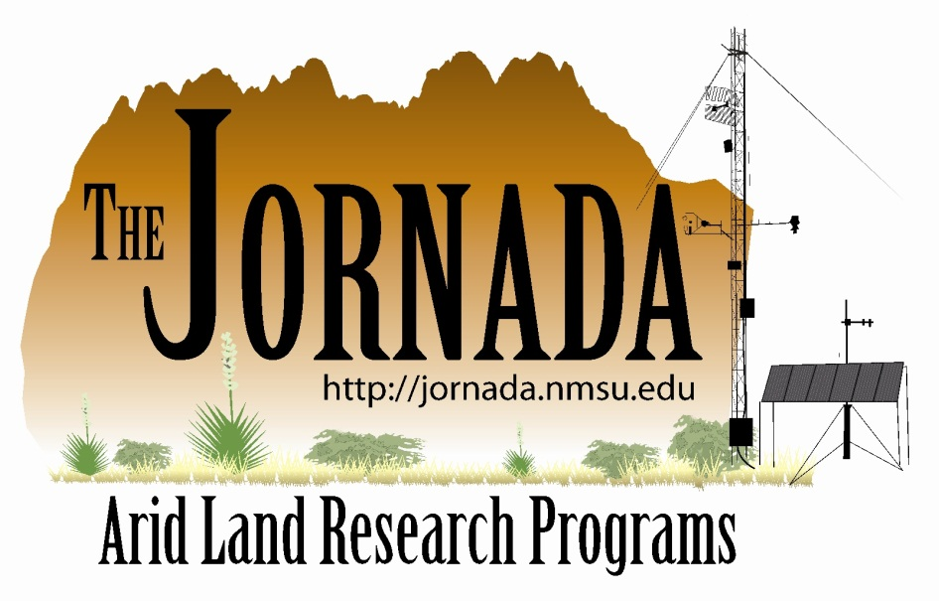
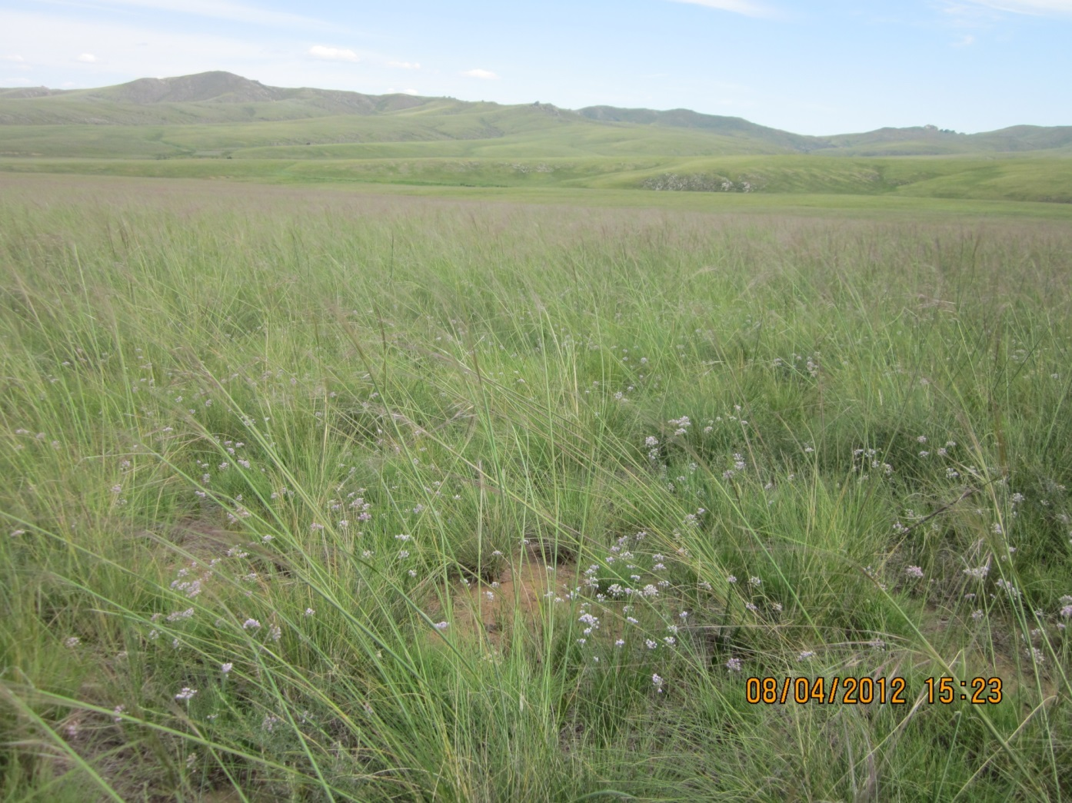
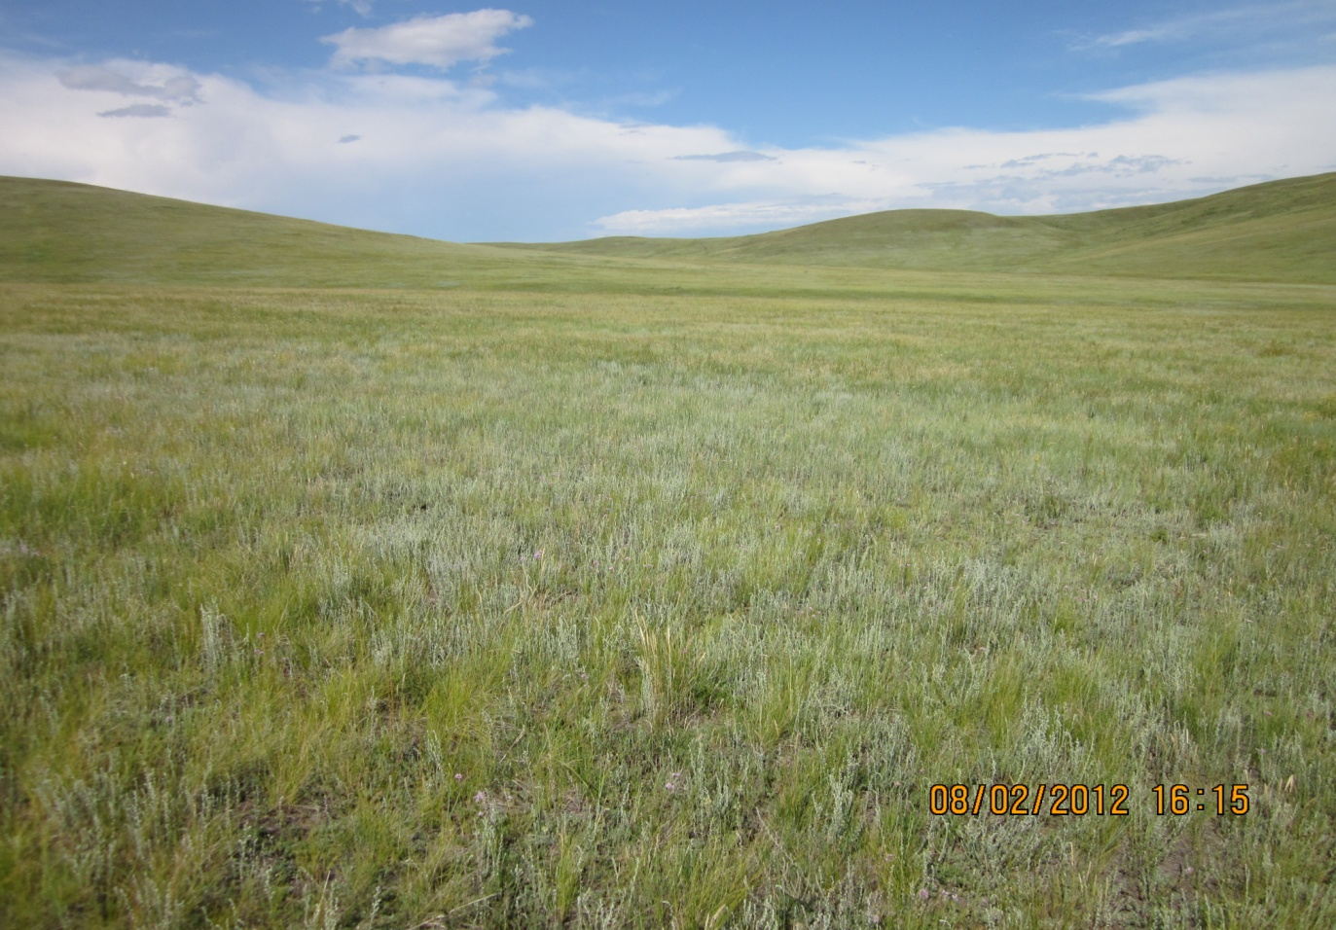
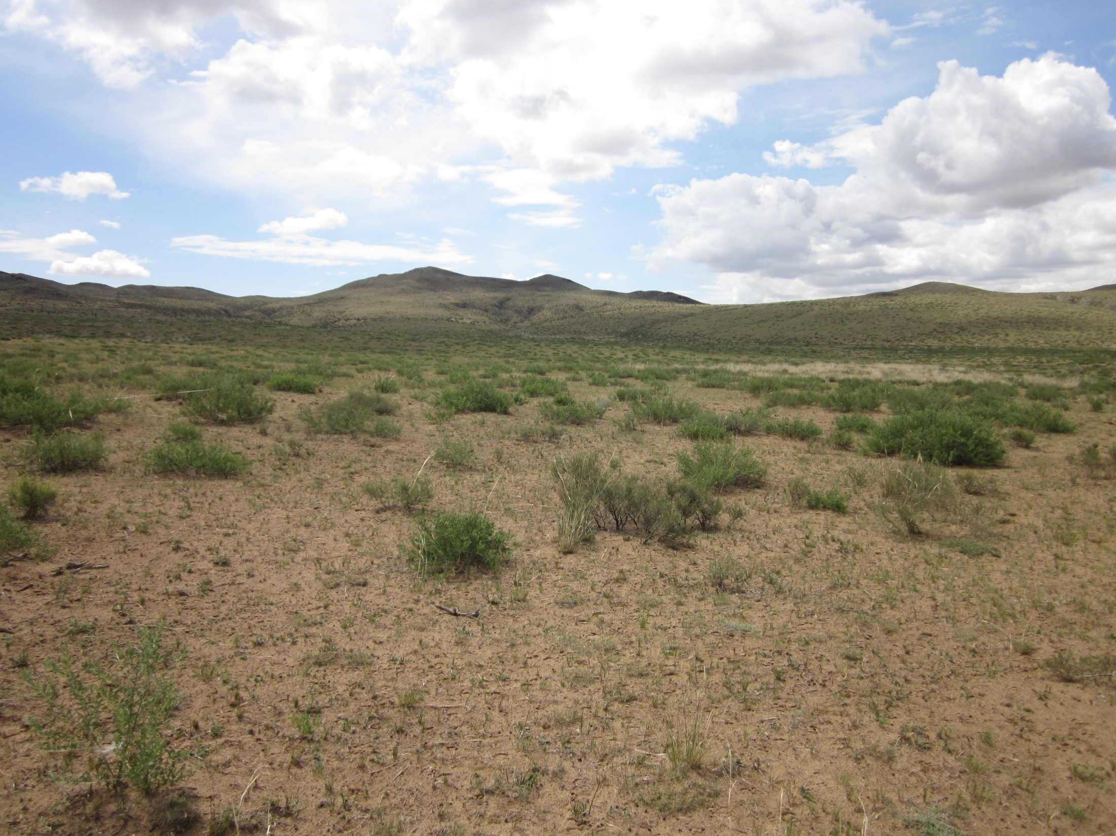
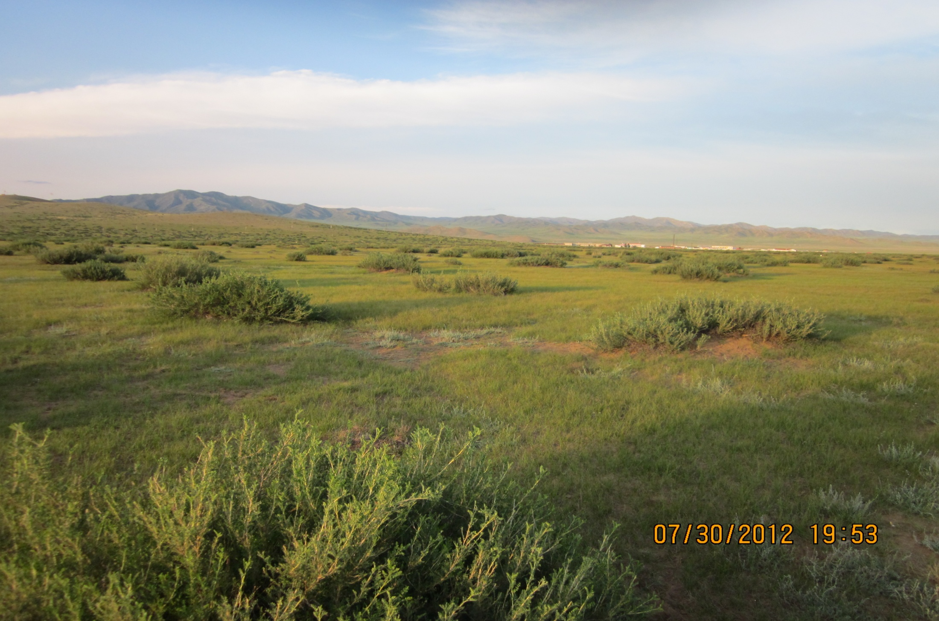
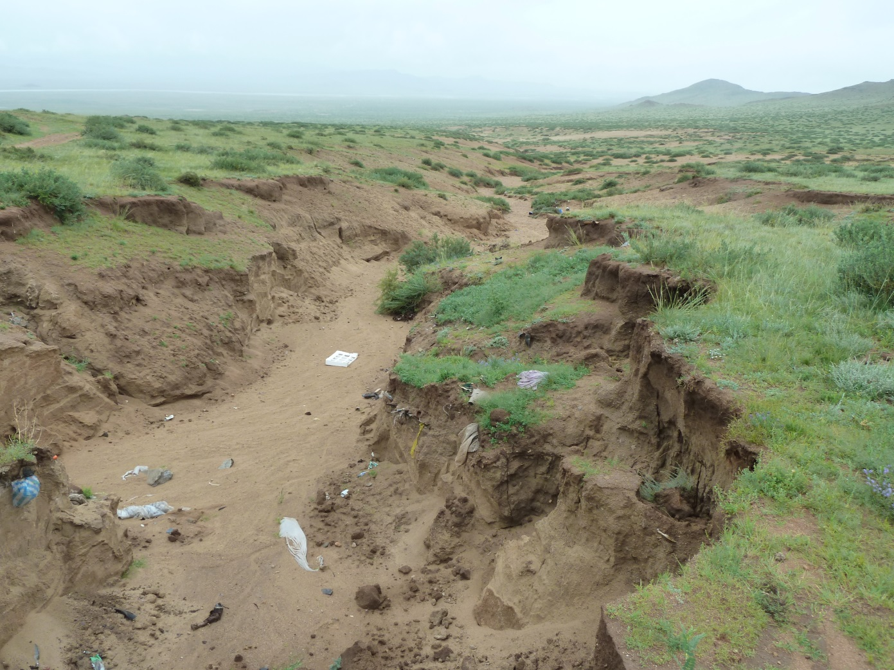
A new approach for reporting desertification: recovery classes
Brandon T. Bestelmeyer^{1*}, Bulgamaa Densambuu², Budbaatar Ulambayar³, Ankhtsetseg Battur³
¹USDA-ARS Jornada Experimental Range, ²Green Gold, SDC Mongolia, ³ALAGCAC *bbestelm@nmsu.edu
Introduction
Desertification refers to persistent and severe reductions in biological productivity due to land uses, usually in combination with climatic and societal factors. Unfortunately, the specific conditions that qualify as desertification or land degradation are poorly defined and subject to great disagreement. For example, reports of desertification in Mongolia vary from 9-90%. Furthermore, current desertification classes (e.g., severe, moderate, slight) do not indicate either the processes and timeframes of degradation or recovery. In particular, information about potential recovery options is essential for translating assessment into management actions that improve land conditions and human livelihoods.
Here, we introduce a 5-level classification of recovery potential, called “recovery classes”. They are based on common patterns of rangeland dynamics observed worldwide.
While the logic underpinning the applications of these classes to a particular land area is science-based, it must be recognized that in Mongolia, the classes represent testable hypotheses that can be verified or disproven through management actions followed by monitoring.
Recovery classes
Recovery classes are based on information and assumptions regarding land potential (the plant communities expected to exist at a site in good condition) and the process of recovery. Assigning a recovery class to a site requires measurements of plant cover, observations of soil surface conditions, and information about the soil and climate context. A state-and-transition model developed for a land class, such as sandy to loamy slopes and valley bottoms in Typical Steppe, Caragana-Stipa krylovii, can be used to assign recovery classes.
Class I The plant community is at or near reference conditions (viz not degraded), no action required, maintain current management
Class II The plant community is altered and may be rapidly recovered (one to several growing seasons) with favorable climatic conditions and/or a change in management (e.g., seasonal deferment, rotation). The nature of alteration is not regarded as a significant long-term threat to the provision of forage and other ecosystem services
Class III The plant community is altered and may take several years to over a decade to recover with changed management (seasonal deferment and long-term rest). Alteration represents a significant loss of important ecosystem services (and are clearly related to anthropogenic drivers), but recovery is possible in time.
Class IV The plant community is altered due to the local loss of key plant species, invasion of noxious plant species, or alteration of hydrology that is unlikely to be recovered for well over decade to many decades, if ever, without intensive interventions such as species removal, seeding, or manipulations to recover historical hydrological function. Previous ecosystem services have been lost and are usually costly to recover.
Class V The plant community is altered due to extensive soil loss, accelerated erosion rates, or salinization. Altered plant-soil feedbacks or permanent changes in the soil profile maintain the degraded state. Previous ecosystem services have been lost and it is usually impractical to recover them (often regarded as true desertification).
Class I
Reference state dominated by Stipa krylovii at 35% foliar cover, full complement of species present
Class II
Stipa cover has declined to 6-10 % . Artemisia frigida (1-3%) and Carex duriuscula (<1%) cover is low. Can be recovered rapidly .
Class III
Stipa cover low (6%) and Caragana remains as dominant. May take several years to recover high Stipa cover
Class IV
Artemisia frigida and Carex dominant in formerly Stipa-dominated grassland with no remnant Stipa present. Carex-Artemisia dominance likely to persist for decades.
Class V
Deep gully with extensive soil loss, production of area is permanently reduced

